Slide 1


Risk of Type-2 Diabetes in Female Pima Indian's Living in the United States.

Slide 2
Guided question
The relationship among gravidity, obesity, and non-insulin-dependent mellitus in “Pregnant Pima Indians”. A study of diabetes were evaluated in both cross-sectional and longitudinal analyses.
OBJECTIVE:
Type 2 diabetes and obesity have genetic and environmental determinants.
We studied the effects of different environments on these diseases in American Indians living in the United States.
Tools Used
Pandas, Matplotlib, Tableau, Seaborn and Machine Learning(ML).

Slide 3
Introduction:
The term diabetes is the shortened version of the full name Diabetes Mellitus.
Diabetes mellitus is derived from the Greek word diabetes means siphon - to pass through and the Latin word mellitus means honeyed or sweet.
All because in diabetes excess sugar is found in blood as well as urine. During the 17th century it was known as the “pissing evil”.

Slide 4
Data sourcing and Data Preparation
This data was collected by the National Institute of Diabetes and Digestive
& Kidney Disease .
The Dataset had 768 individual records and 9 columns.
We noticed that 347 of the rows had missing and unacceptable values, which meant that we had to do some data cleaning and manipulation.
We dropped all values with missing and unacceptable values; and replaced such values with imputed means from the available data using pandas.
The “class” column (the dependent variable), which was a categorical variable in the original data, got manipulated into numeric indices.

Slide 5
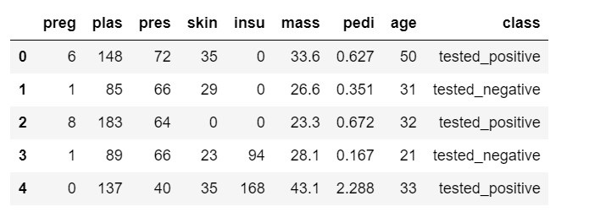
Sample of the raw dataset obtained

Slide 6
Description of data
1. Preg = Number of times pregnant
2. Plas = Plasma glucose concentration
3. Pres = Diastolic blood pressure (mm Hg)
4. Skin = Triceps skin fold thickness (mm)
5. Insu = Insulin in-take (mu u/ml)
6. Mass = Body mass index (weight in kg/(height in m)^2)
7. Pedi =Pedigree diabetes function
8. Age = Age (years)
9. Class = Class variable (0 or 1)

Slide 7
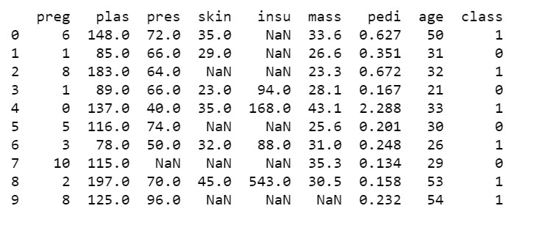
Datasets Cleaning continued…
Before they can be replaced with imputed means, Unacceptable and missing values were replaced with NaN.
Categorical values were replaced with numeric values of 0 or 1 (Col 8)

Slide 8
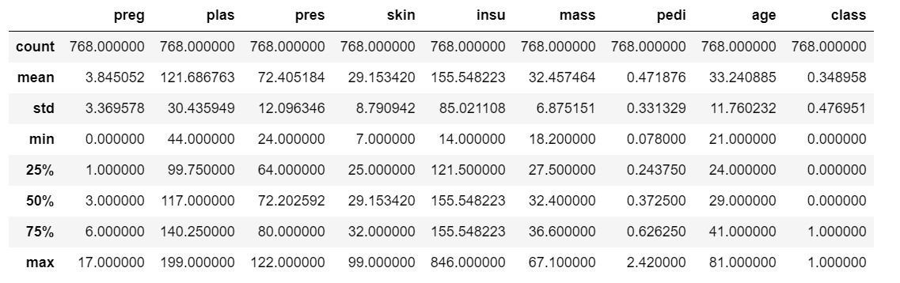
Replacing zero values with Nan
Missing values have been imputed for and Minimum values of 0 are shown where they could be logically explained.

Slide 9
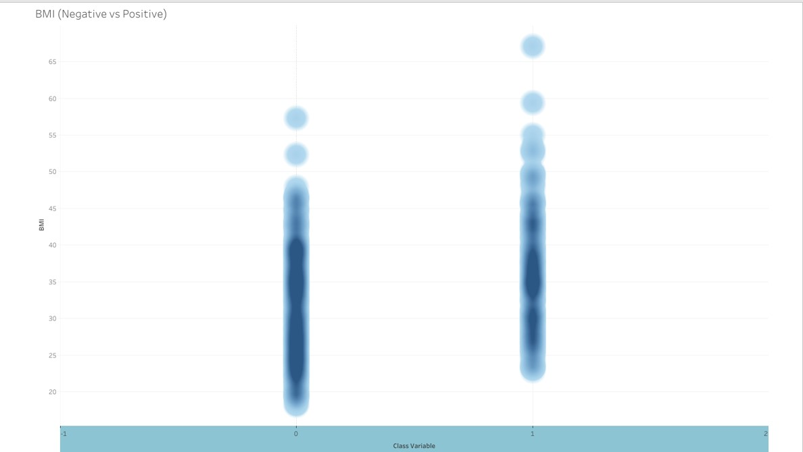
BMI (Negative vs Positive)
This graph compares the recorded BMI data for each individual in the study with a positive and negative result.
The darker the portions of the graph show a higher concentration of individuals with BMI (or other variables in future graphs) at that value.
As you can see, individuals that tested negative were more likely to have a lower BMI.
Class variables

Slide 10
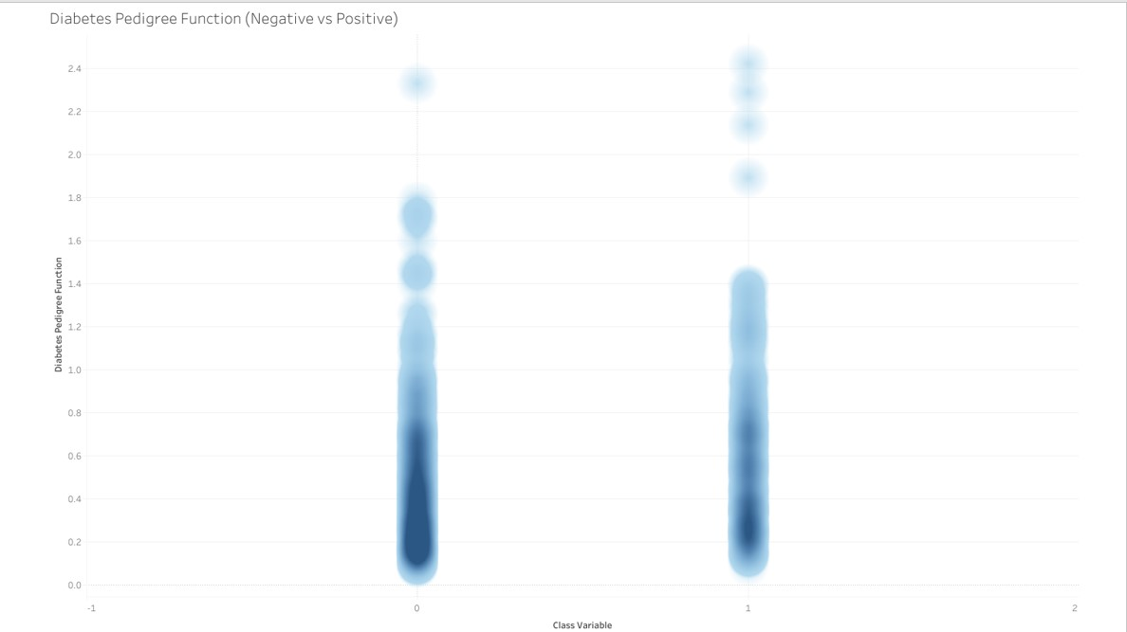
Diabetes Pedigree Function ( Negative vs Positive)
This shows the Diabetes Pedigree Function for individuals that tested positive and negative.
Class variables

Slide 11
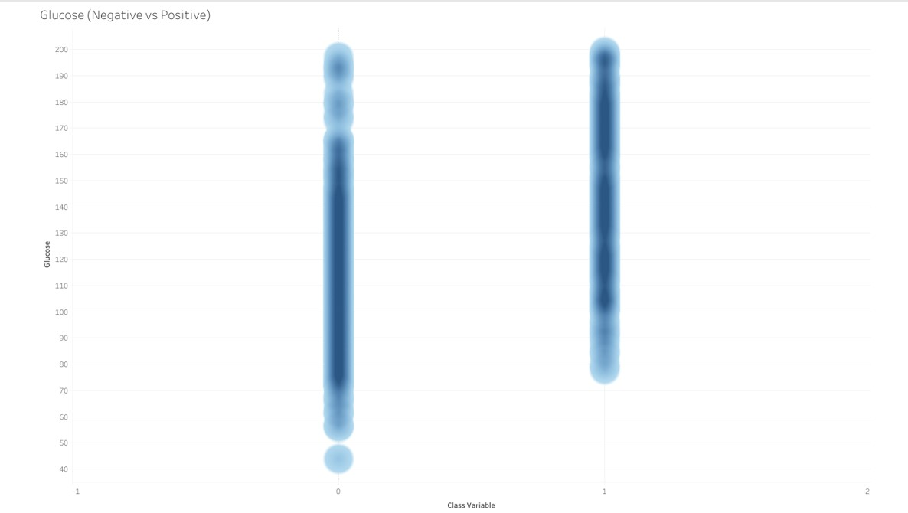
Glucose ( Negative vs Positive)
This shows the Glucose levels for individuals that tested positive and negative.
The glucose level for individuals that tested positive is concentrated at a higher glucose level than those that tested negative.
Class variables

Slide 12
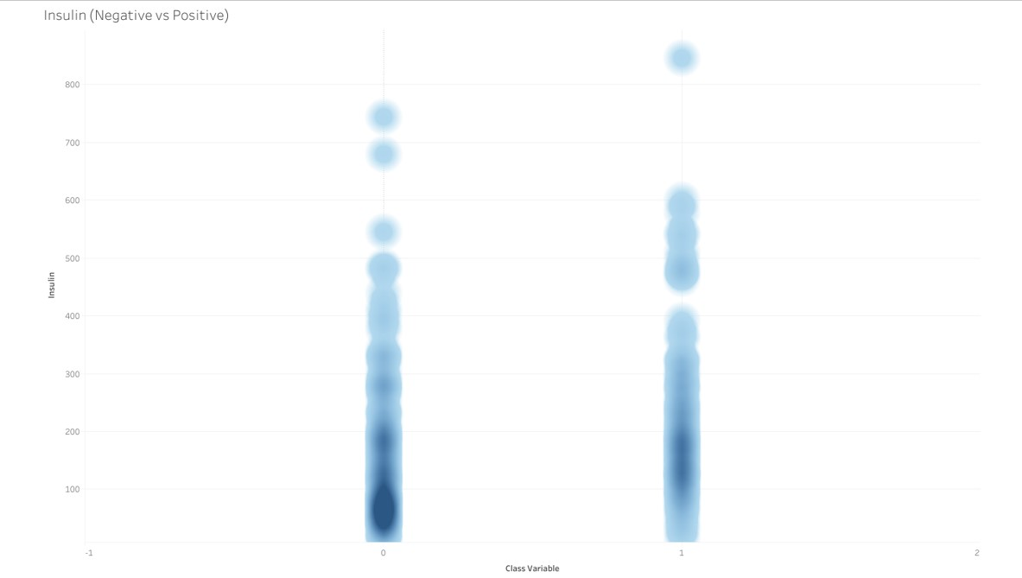
Insulin ( Negative vs Positive)
This shows the Insulin levels for individuals that tested positive and negative.
The insulin level for individuals that tested positive is concentrated at a higher level than those that tested negative.

Slide 13
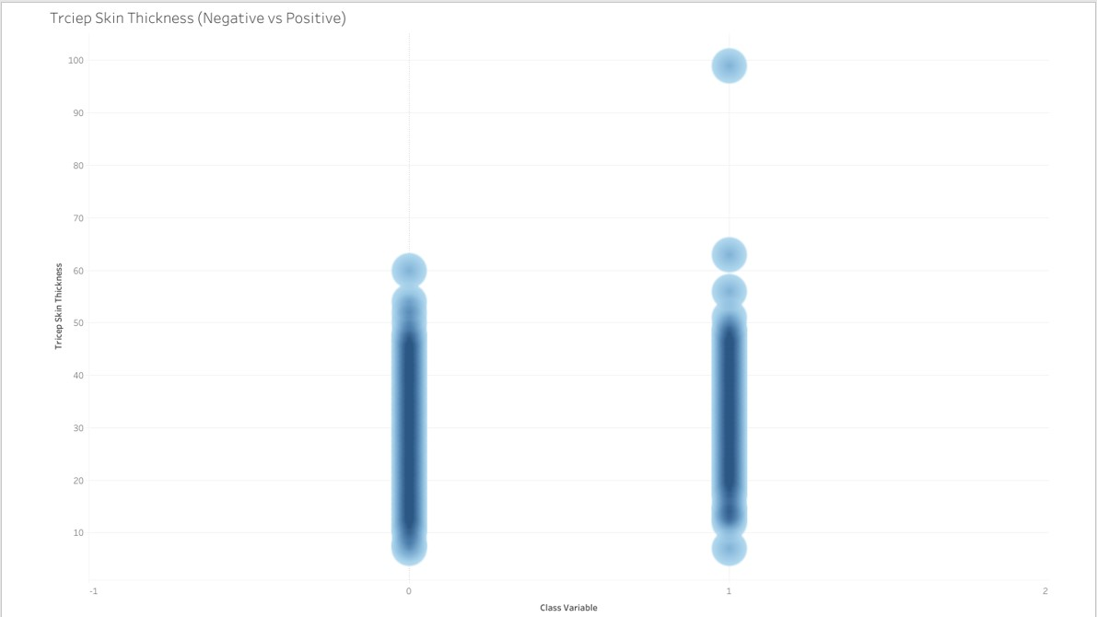
Triceps Skin Thickness (Negative vs Positive)
This shows the Triceps Skin Thickness for individuals that tested positive and negative.

Slide 14
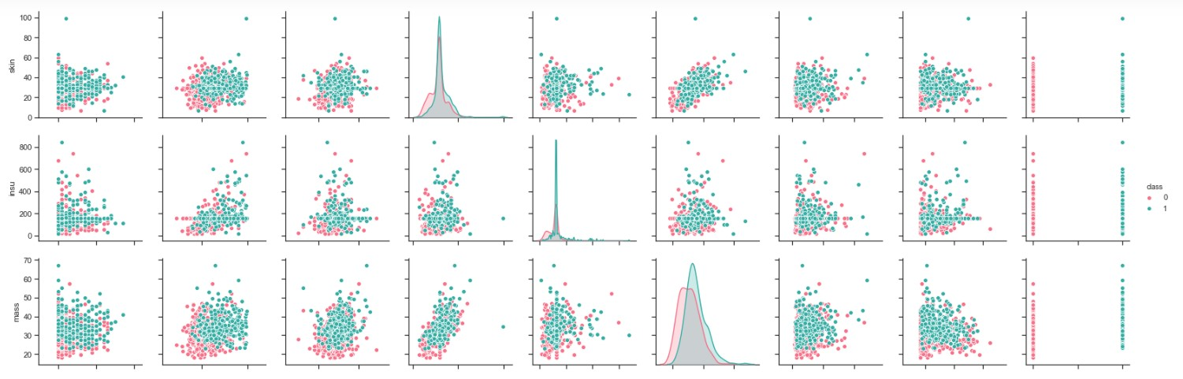
Plotting with all eight variables
Skin
Insu
Mass
perg
plas
pers
skin
insu
Mass
pedi
age
class

Slide 15
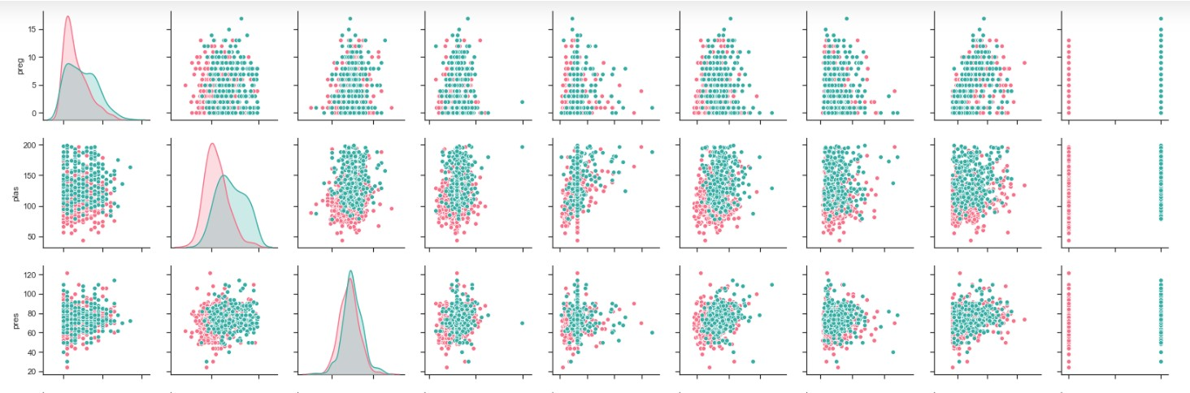
Preg
plas
press
perg
plas
pers
skin
insu
Mass
pedi
age
class

Slide 16
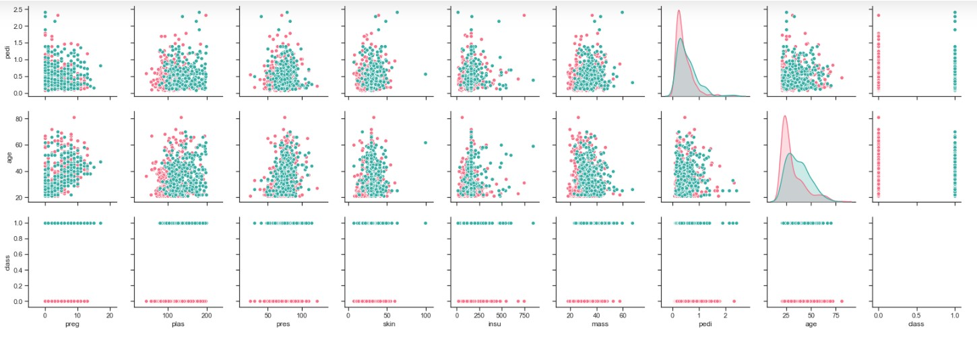
pedi
age
class
perg
plas
pers
skin
insu
Mass
pedi
age
class

Slide 17
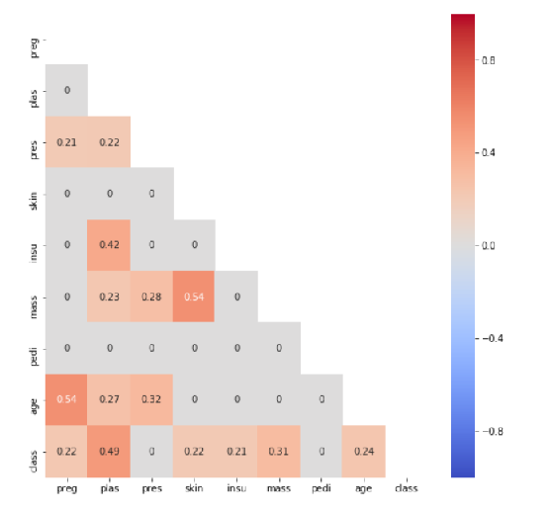
Heatmap
This shows the relative strength of correlation among the various independent variables and with the dependent variable

Slide 18

CONCLUSIONS DRAWN FROM THE WHOLE ANALYSIS
Among the eight variables looked, glucose levels and BMI are shown to have the strongest correlation with diabetes diagnosis.
Surprisingly, blood pressure is found to have a very insignificant correlation with diabetes incidence. Blood pressure is found to have a stronger correlation with age than with diabetes
At least from a commonsense perspective the fact that diabetes pedigree function has a very limited correlation with diabetes diagnosis was a surprising one.

